Slide 1
Exploring the Potential of Head Worn Displays for Manual Work Tasks in Industrial Environments
Summarising Presentation
SEBASTIAN FELIX RAUH

Slide 2
Introduction

Slide 3
The Industrial Environment
German car manufacturer
Shop floor:
  Floor-borne vehicles of several kinds (forklift, transport vehicles, bikes…)
  High noise level
  Clean environment
  High degree of automation
Final assembly on the conveyer belt
Notes:
Clean: no dust, dirt …

Slide 4
Motivation
Access to the production line and its workers
  Include stakeholders from the very beginning
Workers in industrial settings are often supported by “work instruction” systems
  Digital systems, relying on mobile devices like notebooks, hand-held terminals or stationary monitors
  Paper-based system, like step-by-step instructions
→ HWD may be used to enhance the way workers are guided

Slide 5
Research Objective

Slide 6
Research Objective
Exploration of possibilities and limits modern HWDs open up
for industrial applications to support workers
to inform HWD application designers, developers and other decision makers

Slide 7
Studies with Head Worn Displays

Slide 8
Multiphase Project
Initial Start-Up and Functional Check
Driver Assistance System Calibration Bay
In-Lab
Phase I (a)
Initial Introduction of HWD
HWD for Calibration Tasks
Phase I (b)
Augmented Reality I
Phase II
Optimising Energy Consumption
Phase III
HWD Benchmarking
Future Work
Augmented Reality II

Slide 9
Initial Start-Up and Functional Check
Manually and automatically executed functional tasks
  Start-up of the engine → e.g. measurements of exhaust gases
  Testing of control devices
  Build quality
Task with repetitive steps with little / no flexibility

Slide 10
Initial Start-Up and Functional Check
Each vehicle is completely checked by one worker
Workers have to move around and sit in the car, e.g. when
  Checking the tank cover
  Testing the bearing clearance of the steering wheel
  Controlling the lining of the luggage compartment
  Checking the leak tightness of e.g. air condition

Slide 11
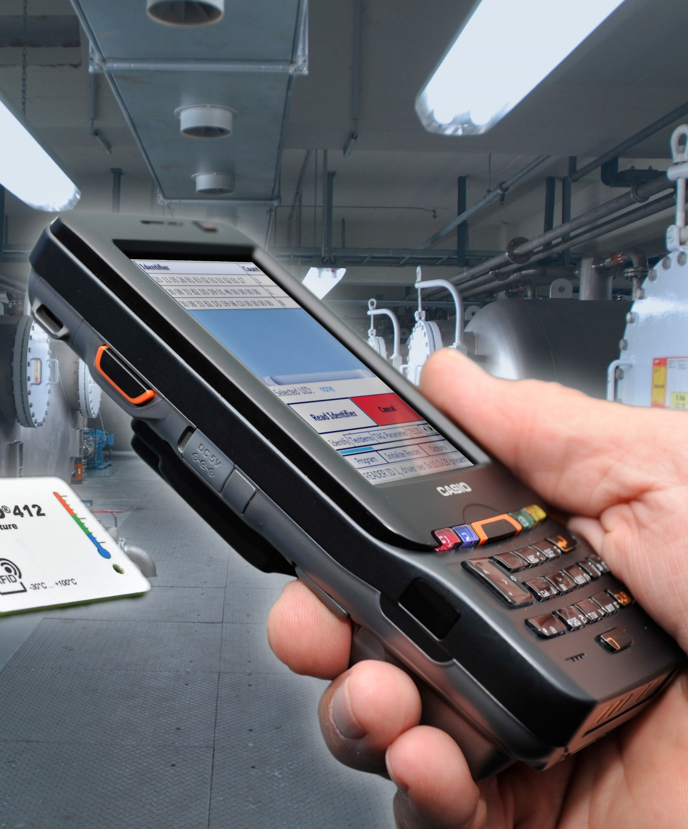
Initial Start-Up and Functional Check
Workers are supported by a hand-held device (CASIO IT-800)
  Identifying vehicles by scanning a barcode
  Log into the system using the plant ID card
  Instructions on the display
  Documentation of executed tasks
For some tasks both hands are needed
  → The device has to be put aside with the risk of dropping or forgetting it

Slide 12
Calibration of the Driver Assistance System
Driver Assistance System Testing Bay
  System to test and calibrate sensors of the driver assistance system
  Calibration of the headlights and the HUD
Weekly, monthly and yearly calibrations
  Calibration of different plant elements
  We selected the regular calibration in Monday morning shift
    → Analysis of the work task can be done every week
Notes:
Example for DAS: Distance sensors which support driver when parking

Slide 13
Calibration of the Driver Assistance System
Workers have different experience levels
  If (unskilled) worker needs longer, assembly line becomes delayed
Calibration has to be finished before the conveyer belt is starting up
  The worker responsible for this task starts 20 Minutes earlier
Paper-based work instruction on table close to the plant
  Especially untrained workers need the instruction in each step of the calibration
    → lengthy routes make the worker insufficient
Notes:
Untrained workers have to walk from the plant part they calibrate to the desk where the documentation is back to the next plant part….

Slide 14
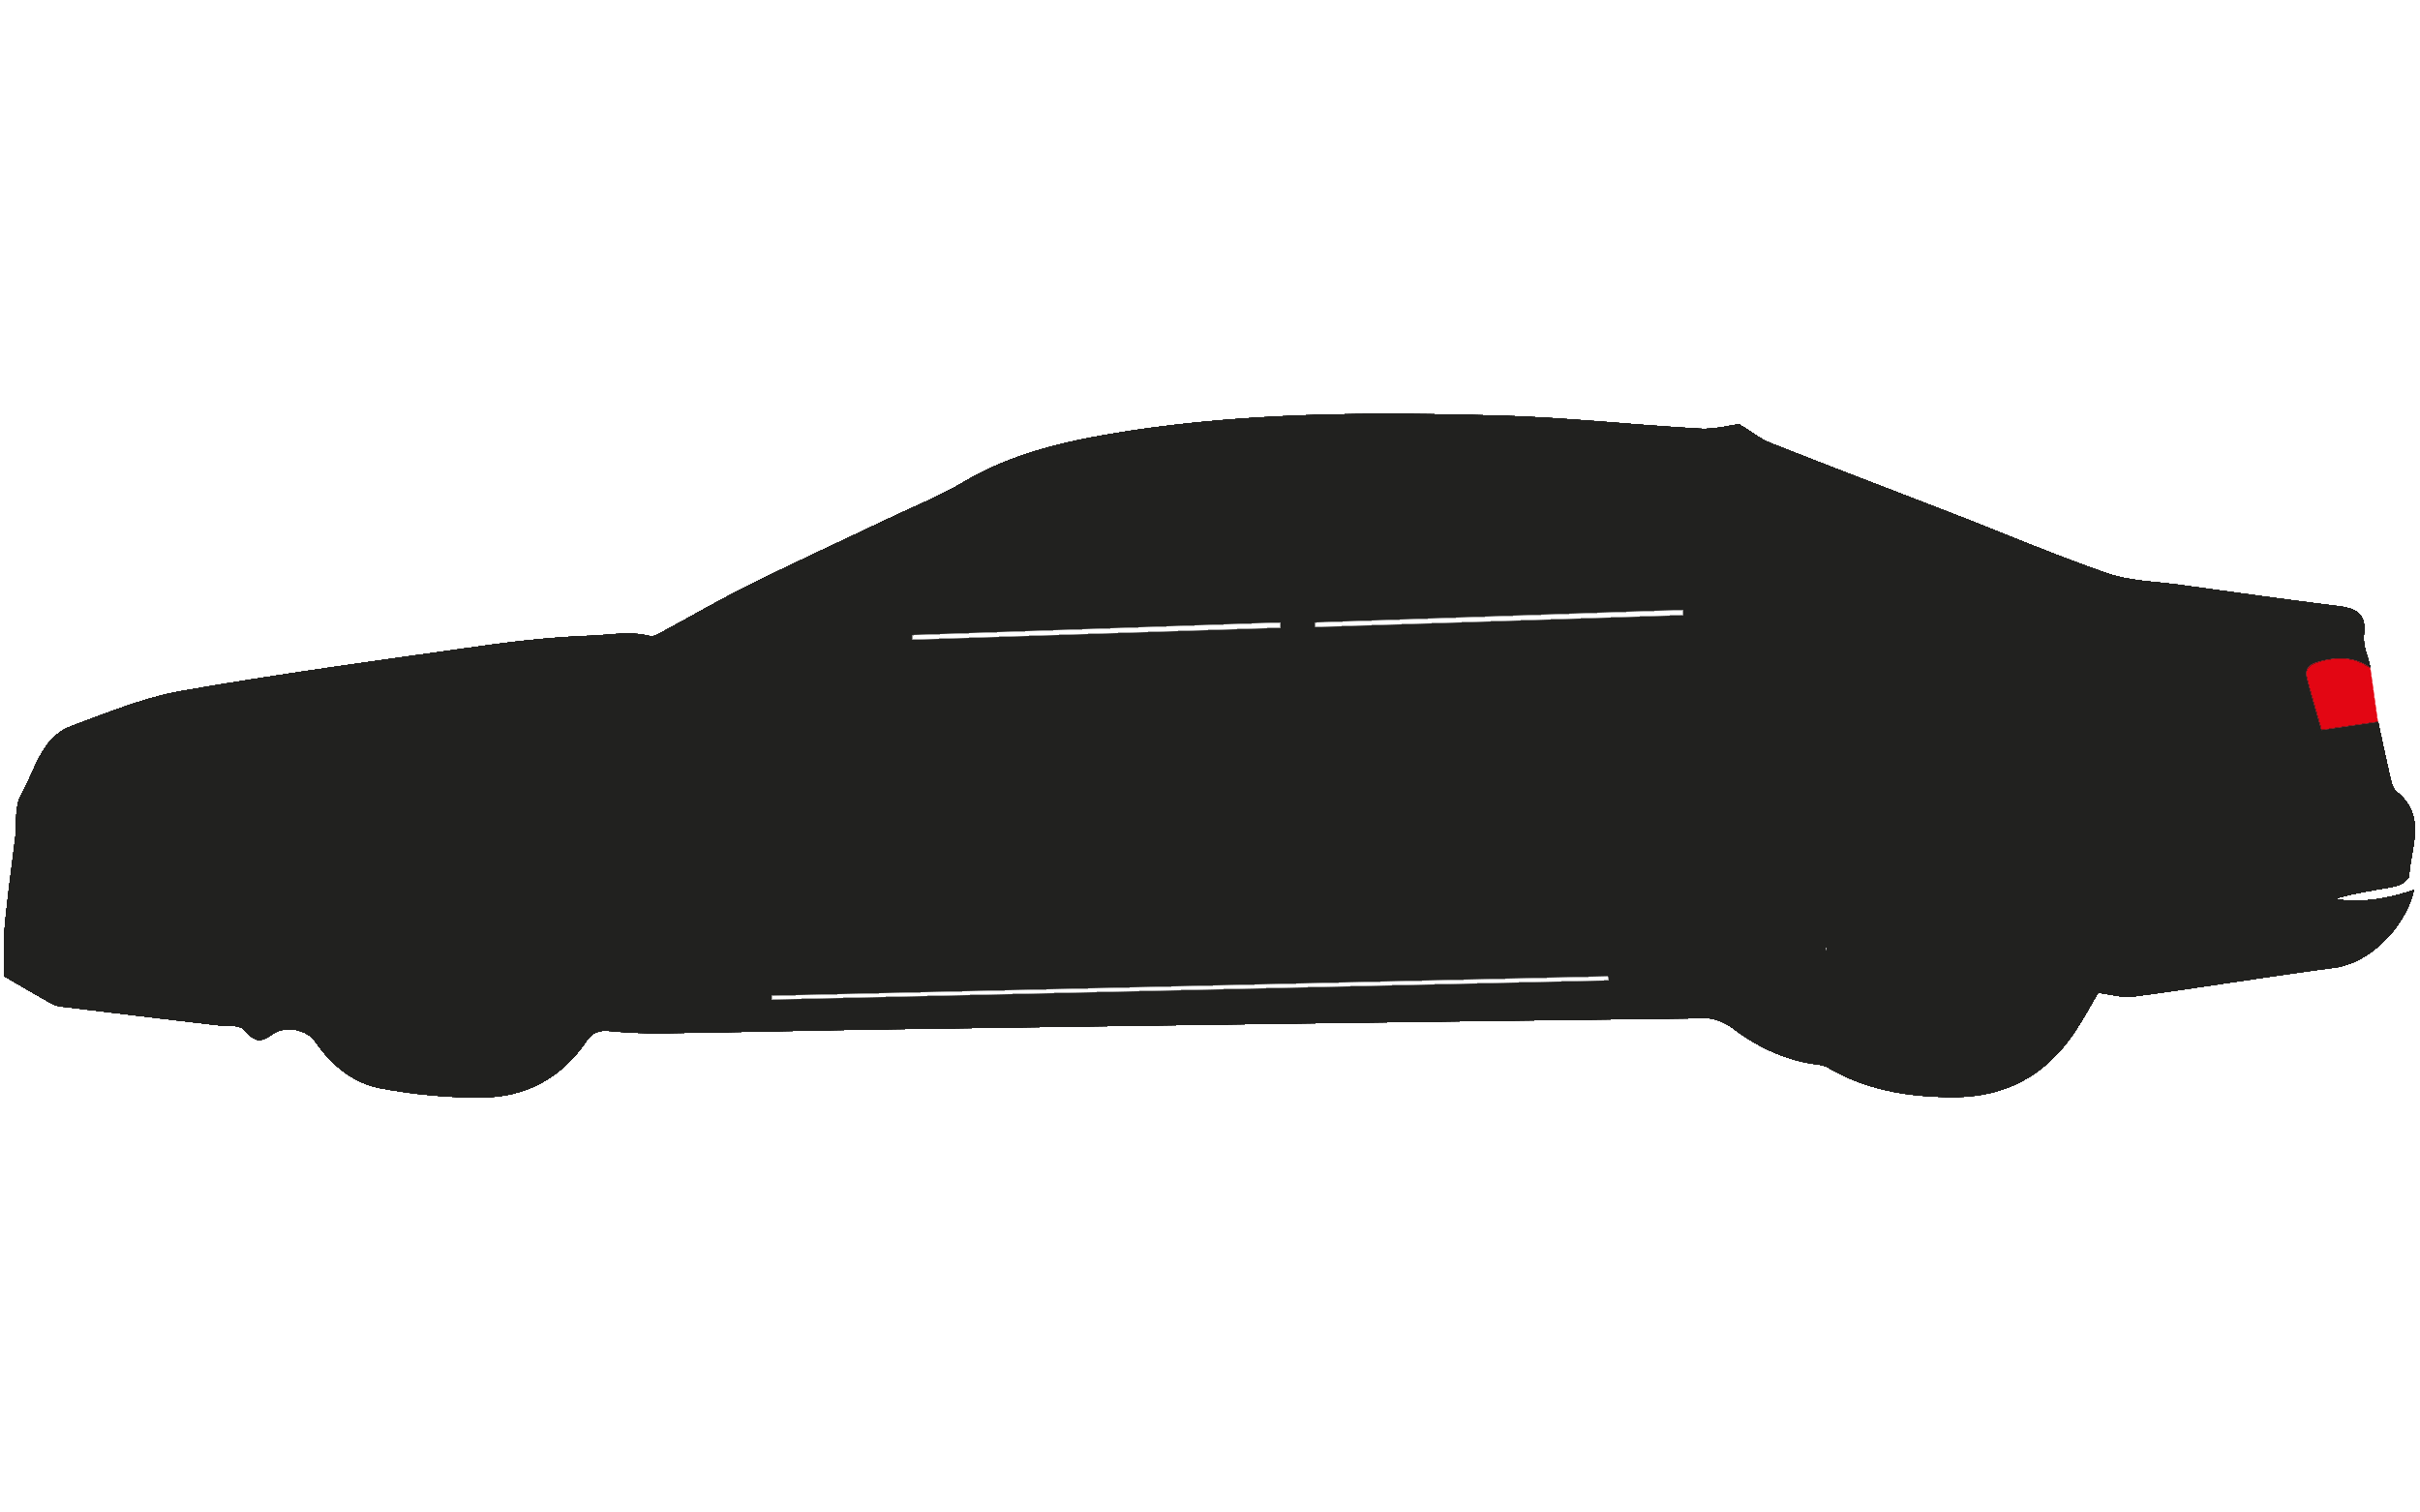
Set-up on the Conveyer Belt
Assembly
Final Check
(Re-) Finishing
ENGINE
VEHICLE
CHASSIS
OTHER
Functional Check and Initial Start-up
Calibration of the Driver Assistance System
Functional Check and Initial Start-up
Calibration of the Driver Assistance System
In-Lab

Slide 15
Initial Introduction of Head Worn Displays
Exploration of user requirements on HWD in industrial environments
  On the production line in the Functional Check and Initial Start-up Division
Goals:
  Proof of feasibility
  User feedback on the device, its usage and the expectations
  Identification of future application areas, potential and limits of HWD
Functional Check and Initial Start-up
Calibration of the Driver Assistance System
In-Lab

Slide 16
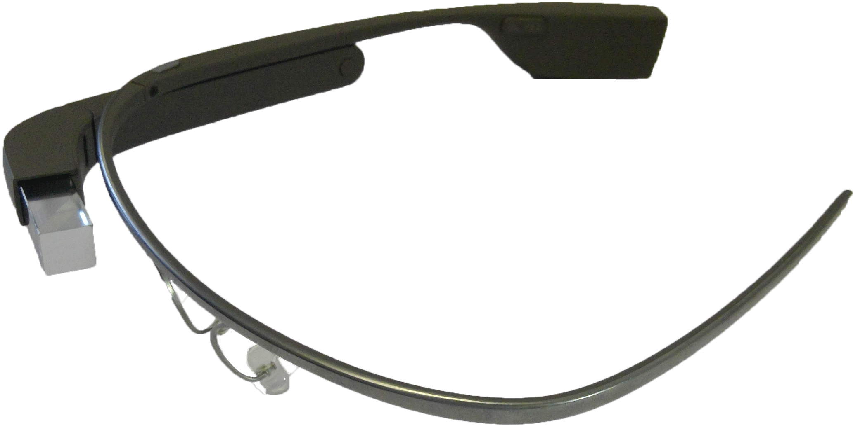
Initial Introduction of Head Worn Displays
Internal Task ID and Name
Success and Progress Indicator
Functional Check and Initial Start-up
Calibration of the Driver Assistance System
In-Lab
Notes:
Leak tightness of air condition

Slide 17
Initial Introduction of Head Worn Displays
Results:
  Users accept HWD in the selected work environment, despite ongoing public discussion
  The application was developed together with the users
    The application has the potential to replace the used software
    Users expect improvements in the work flow
  Users with debility of sight (wearer of glasses) could not use our version of Google Glass.
    Glasses frames are available (requires “personalised” device for each worker)
  Scanning a bar code without additional hand held is tricky
  Google Glass overheated quickly and the battery did not last very long without recharging
    → Prevents introduction of HWDs for the selected division
Functional Check and Initial Start-up
Calibration of the Driver Assistance System
In-Lab

Slide 18
HWD for Calibration Tasks
Calibration task performed ones a week
  Workers have less routine in executing it
Paper-based instructions on a desk
  Extends time depending on the workers level of experience
Goal:
  Validate Results
  Apply to different division and task
Functional Check and Initial Start-up
Calibration of the Driver Assistance System
In-Lab

Slide 19
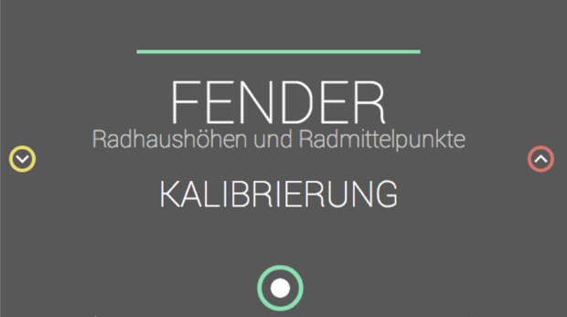
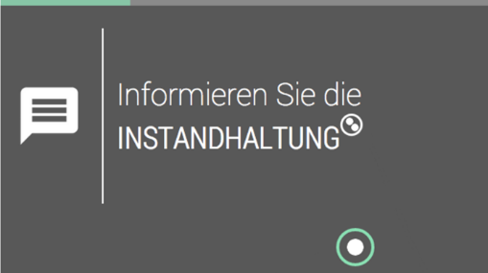
HWD for Calibration Tasks
Trained and untrained workers can perform the task fluently
The application guides them through the process
Conditionals cards
  The user has to mark a calibration-step as „OK“ or „not OK“ or „postponed“
Informational cards
  The user only can confirm. He has to derive and perform the necessary task on his own.
Functional Check and Initial Start-up
Calibration of the Driver Assistance System
In-Lab
Notes:
Fender: calibration of the wheel housing height and the centre of the wheel
Inform the maintenance

Slide 20
HWD for Calibration Tasks
Main results:
  HWD can be used in this area
  The weaknesses of the selected HWD also occured in this project
    Fast Overheating
    Low Battery Runtime
    Usage is new to the workers
  → The weaknesses were limiting the evaluation of the device
Functional Check and Initial Start-up
Calibration of the Driver Assistance System
In-Lab

Slide 21
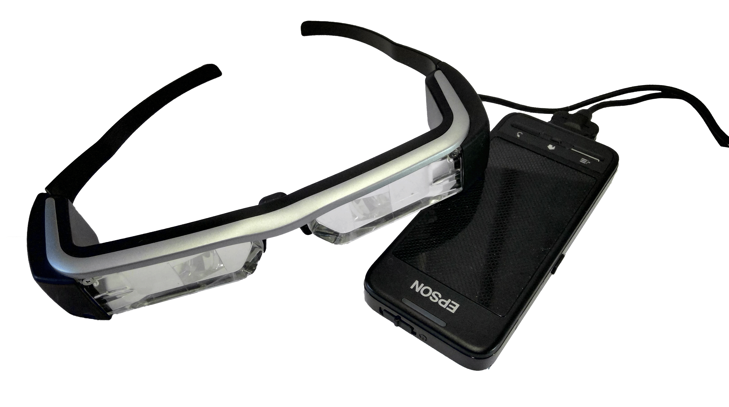
Augmented Reality I
Aim: Redesign our initial of the Google Glass application into a AR application for EPSON Moverio BT-200
Expectations:
  AR has the potential to support workers
  AR instructions can be easier to understand as written instructions
Functional Check and Initial Start-up
Calibration of the Driver Assistance System
In-Lab
Notes:
We selected Epson Moverio as it was the only mobile AR-ready HWD available in our hardware pool
AR might be easier to understand as e.g. the solution of a problem can be displayed

Slide 22
Augmented Reality I
Selected AR Tool-Chain: Metaio Suite
  Content was easy to generate
  Promised good tracking results
Under good lighting conditions tracking objects with the selected HWD was sufficient
  On the shop floor, tracking objects of the engine room failed (see following image)
Functional Check and Initial Start-up
Calibration of the Driver Assistance System
In-Lab
Notes:
We selected Epson Moverio as it was the only mobile AR-ready HWD available in our hardware pool
AR might be easier to understand as e.g. the solution of a problem can be displayed

Slide 23
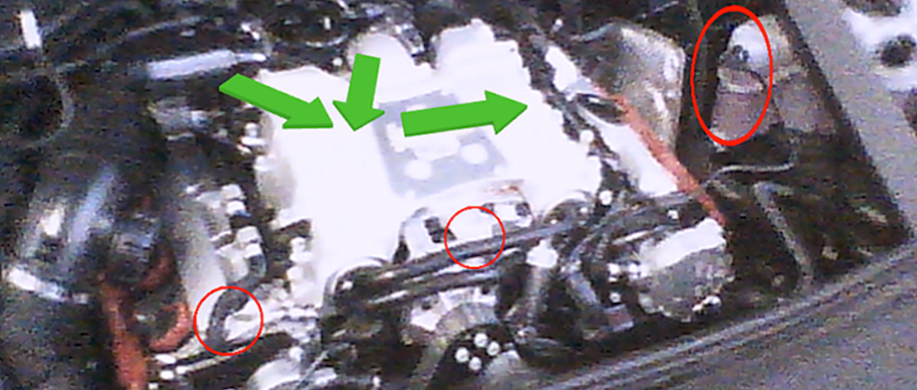
Augmented Reality I
Functional Check and Initial Start-up
Calibration of the Driver Assistance System
In-Lab
Notes:
Photo shows the engine room

Slide 24
Optimising Energy Consumption
Problems with Google Glass in the previous projects:
  fast overheating
  high energy consumption
We picked the Google Glass application for the Functional Check and Initial Start-up
Examination of the energy consumption of Google Glass
According to literature the main energy consuming components are
  Camera: image and video capturing
  Processor: image processing
Functional Check and Initial Start-up
Calibration of the Driver Assistance System
In-Lab

Slide 25
Optimising Energy Consumption
Camera - Strategies
  Parameters of the camera preview
    Refresh Rate
    Preview Resolution
  Minimise share of overall runtime of the device
  → Implementation of barcode image processing library (ZXing)
    Offers full adaptability (open source project)
    Supports all common barcodes
Functional Check and Initial Start-up
Calibration of the Driver Assistance System
In-Lab

Slide 26
Optimising Energy Consumption
Processor - Strategies
  Optimising CPU clock rate
  Selection of the most appropriate Governor
  Rooting the device is necessary
Functional Check and Initial Start-up
Calibration of the Driver Assistance System
In-Lab

Slide 27
Optimising Energy Consumption
Device was running about 2 h without shutting down
  With additional battery pack this can be extended to one work shift (8 h)
Added-Value Analysis (performed in the Finishing division):
  The reworked application has been used in a test setting
  7 participants executed selected tasks after familiarising with the interaction
  Overall they were 26 s faster with Google Glass (~ 2%)
Users stated:
  “The usage of the HWD is a great facilitation”
  “Barcode scanning is easier with a hand-held device”
  “The biggest advantage most probably is that I have both hands free”
Functional Check and Initial Start-up
Calibration of the Driver Assistance System
In-Lab
Notes:
After Training we expect increase

Slide 28
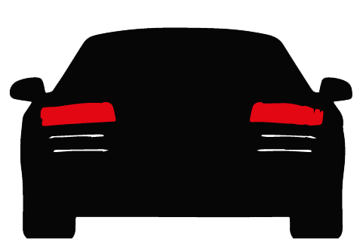
Head Worn Display Benchmarking
The group of HWD still is diversifying
Manufacturers, developers, designers and early adopters are exploring their possibilities and limitations
They need for a tool to make informed decisions about which HWD to use in their software projects
  To convince other stakeholders, e.g. to select the most suitable device
  To be aware which device fulfils the requirements in the project the best
Functional Check and Initial Start-up
Calibration of the Driver Assistance System
In-Lab

Slide 29
Head Worn Display Benchmarking
Aim: Development of a Android benchmark suite for “professional users”
  Empower the users to run their own benchmark tests
  Grant access to a database to compare with other devices
Identification of the key features of HWD using literature and own experience
  Camera: For object recognition a high quality camera image is needed
  CPU: Some tasks cannot be outsourced to a backend system
  Battery: the grade of mobility of any devices depends on the capacity of its battery
  Positioning Service: Many use cases include the usage of the devices current position
Functional Check and Initial Start-up
Calibration of the Driver Assistance System
In-Lab

Slide 30
Head Worn Display Benchmarking
Assumptions:
  A school grade like rating system is easy to understand
  For object detection the noise share and the precision in edge detection are the most important parameters
  HWD need to be able to pre-process captured streams, perform simple encryption and decryption and render 3D objects
    High performance tasks will be outsourced to a powerful backend system
  State of the art-smartphone can be used as CPU reference device
Functional Check and Initial Start-up
Calibration of the Driver Assistance System
In-Lab

Slide 31
Head Worn Display Benchmarking
Challenges:
  For camera testing the lighting conditions are crucial
  For GPS-testing any obstacle close to the device can influence the results
But we want the user to perform this benchmarking?
  Inform user about how to overcome this problems
  Make clear that these measures depend on the users performance
Functional Check and Initial Start-up
Calibration of the Driver Assistance System
In-Lab

Slide 32
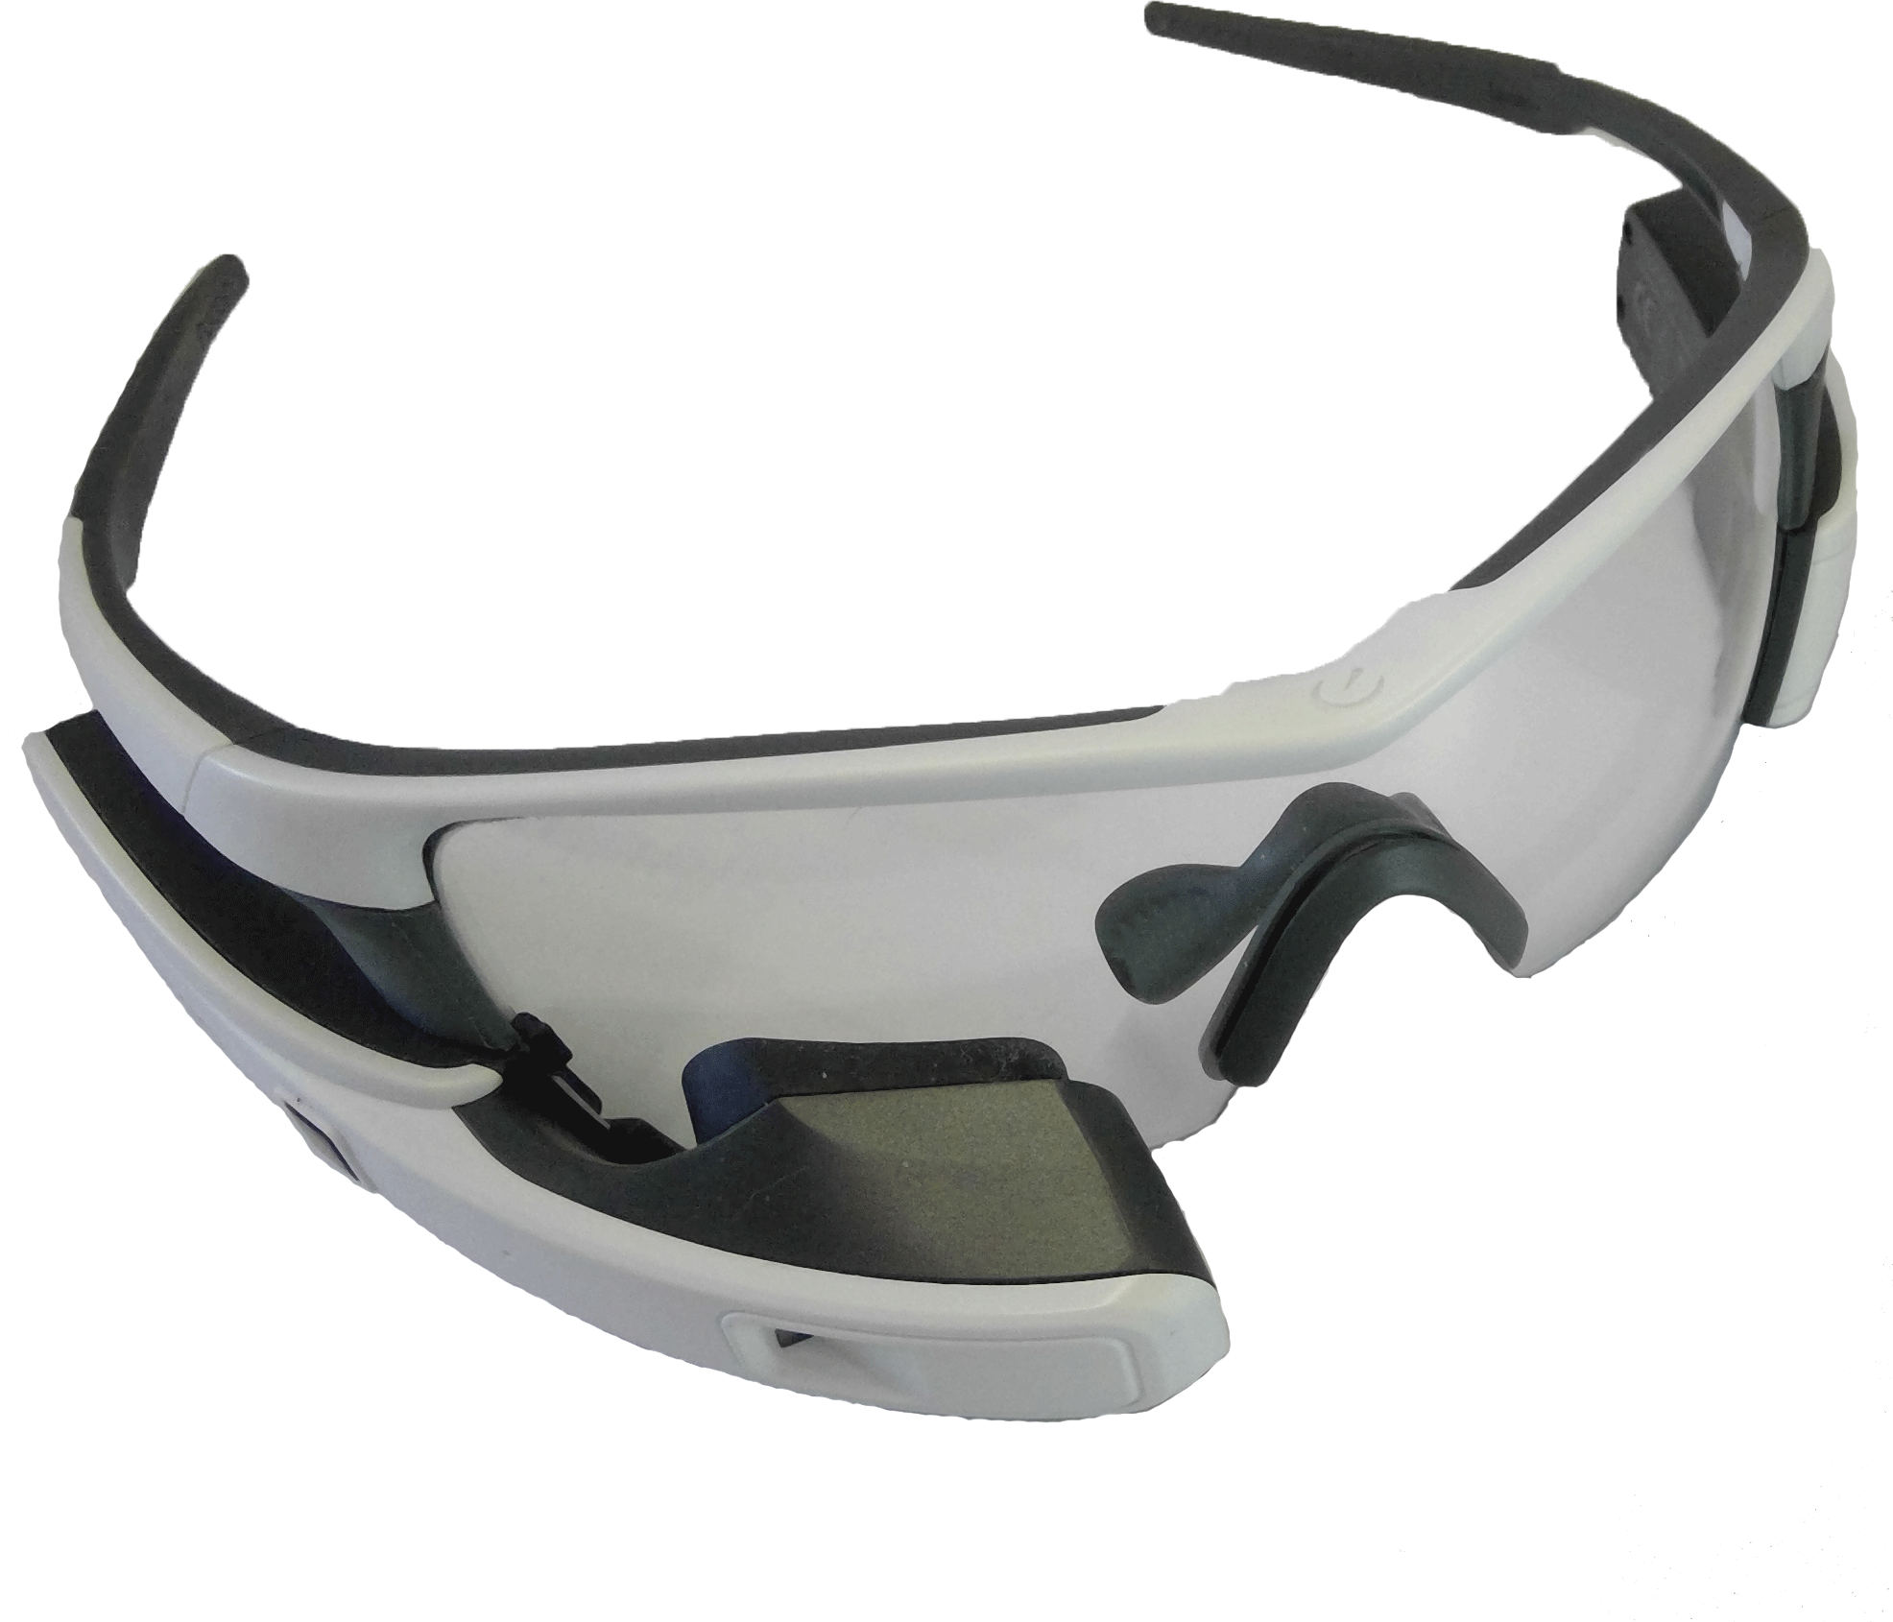
Head Worn Display Benchmarking
We used Recon Jet and Epson Moverio BT-200
We selected German school grades (1: very good – 6: fail)
Tests performed:
  7 CPU tests (incl. measurement of battery drain)
  2 camera tests
  2 GNSS tests
Functional Check and Initial Start-up
Calibration of the Driver Assistance System
In-Lab

Slide 33
Review on the Studies

Slide 34
Issues with the used HWD
Unstable Software: Beta-software and Developer Kits
Prescription Glasses: Most manufacturers offer a solution
Interaction Concept: People need to get used to it
Battery Runtime: Can be extended by adjusting source code
Overheating: Closely related to the processing load

Slide 35
Major Findings
Diversity of HWD and interaction concepts
  Decision makers have to be able to make an informed decision. Therefore they need support
HWD can be used for worker support, they also enable digitally supporting users in new areas
HWD expose the worker to the risk of being (unintentionally) observed

Slide 36
Overview
Initial Start-Up and Functional Check
Driver Assistance System Calibration Bay
In-Lab
Phase I (a)
Initial Introduction of HWD
HWD for Calibration Tasks
Phase I (b)
Augmented Reality I
Phase II
Optimising Energy Consumption
Phase III
HWD Benchmarking
Future Work
Augmented Reality II

Slide 37
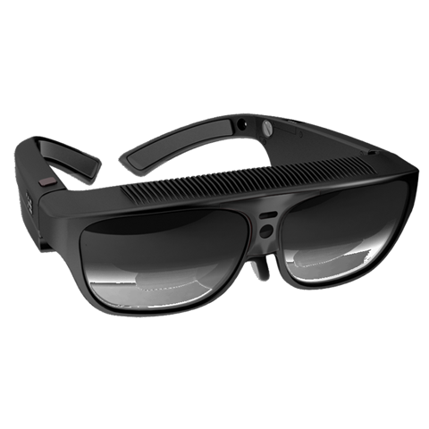
Augmented Reality II
New hardware Generation: ODG R-7
New AR Toolchain: Vuforia
  Metaio was sold and services were shut down
New application area: Passenger Compartment / Centre Console
Current Status: Analysis of the results
Functional Check and Initial Start-up
Calibration of the Driver Assistance System
In-Lab
Notes:
New generation as ODG R-7 has a better camera, a better CPU, a better display technology
New application area because of stakeholder feedback and also because we have a car simulator based on a AUDI S8 in the Lab (no engine)

Slide 38
Access the Thesis on KTH DIVA http://urn.kb.se/resolve?urn=urn:nbn:se:kth:diva-206119

